Slide 1
TDI: Julia
Data Types in Julia
William Mui

Slide 2
Data Types

Slide 3
What is data types?
Computer store information in binary
Decide how to “decode” the data
For example, computer store the integer 65 for character ‘A’
Totally the same with Unsigned integer 65
If you are entering a very large number, DO NOT add commas.
✅1000000000
❌1,000,000,000

Slide 4
Primitive Types

Slide 5
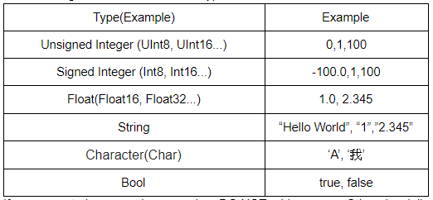
Primitive Types

Slide 6
Unsigned Integer
Store data in binary
The minimal value could be stored is 0
Types(Max value):
UInt8 (255)
UInt16 (65,535)
UInt32 (4,294,967,295)
UInt64 (18,446,744,073,709,551,615)
UInt128 (340,282,366,920,938,463,463,374,607,431,768,211,455)

Slide 7

Signed Integer
Store data in two’s complement
Types(Range):
Int8 (-128 to 127)
Int16 (-32,768 to 32,767)
Int32 (-2,147,483,648 to 2,147,483,647)
Int64 (-9,223,372,036,854,775,808 to 9,223,372,036,854,775,807)
Int128 (−170,141,183,460,469,231,731,687,303,715,884,105,728 to 170,141,183,460,469,231,731,687,303,715,884,105,727)
The most commonly used is Int64

Slide 8
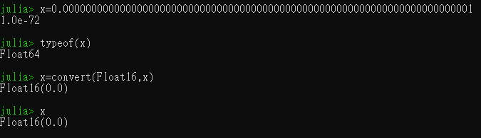
Float
Store data with IEEE 754 standard
With some limitation, cannot store too precise numbers
Types:
Float16
Float32
Float64

Slide 9

Bool(ean)
Using 8-bits (1 byte)
Store True or False

Slide 10
Types in Julia
Dynamically typed
Use convert(<Type>,<Variable>) if necessary

Slide 11
Composite Types

Slide 12
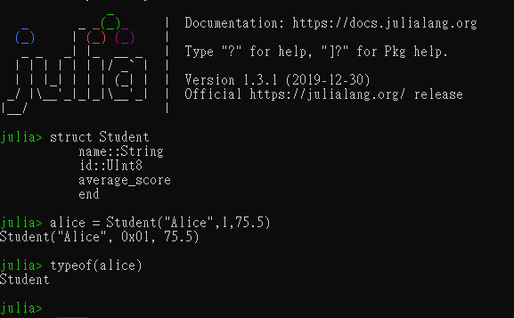
Composite Types
Defined by user
Collection of variables
Called records, structs, or objects in various languages
Organizing related variables

Slide 13
Define a Composite Types
Using keyword “struct”
Follow with the name of the type
Create a new line for each variable
Define the type by :: operator, if necessary
Use “end” keyword to finish

Slide 14
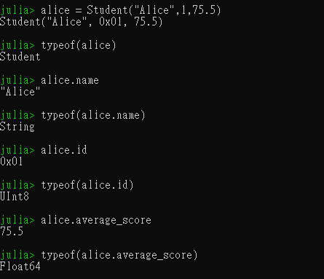
Create & Access the variable
Using the format:
<variable name> = <type name>(args)
Using dot to access the variables inside the composite types
Julia will decide the types of variables inside, if it is not defined

Slide 15

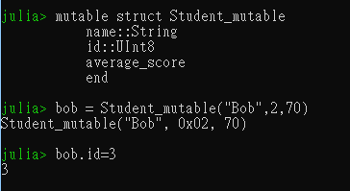
Mutable Composite Type
The previous one is immutable
Once the variable is created, cannot change the values inside
Add “mutable” keyword if necessary

Slide 16
Type Unions

Slide 17
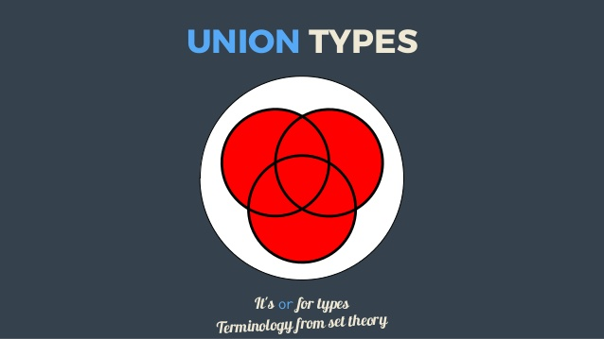
Type Unions
User defined type
Defines a new type union containing several types
Data under the type must be either one of the data types defined
Photo source: https://www.slideshare.net/yoozd/union-types-and-literal-singleton-types-in-scala-and-typescript

Slide 18
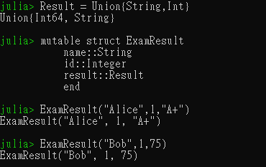
Define a type union
Using the keyword “Union”
Format:
Union{<types}
Directly assign value under the type union

